Slide 1

Rockbuster
State of the Business
February 2020

Slide 2


Digital Transition
Current Business Model
Future Business Model
Rockbuster has relied on its global network of stores to rent physical copies of the movies it holds.
Times have forever changed and we need a strategy as we look to our digital streaming future
How do we translate our existing success to a digital platform template?
We’ll need to understand:
Who our customers are
Where our customers are
Which movies are hits
How often movies are consumed

Slide 3





Movie Metrics
Total Rental Revenue: $61,312
Total Movie Titles 1000
Highest-Grossing Film
Telegraph Voyage $215.75
Average Rental Rate
$2.98
Lowest-Grossing Film
Texas Watch Oklahoma Jumanji Duffel Apocalypse $5.94
Revenue-to-Replacement Cost Ratio:
3.07
Average Replacement Cost:
$19.98
Replacement Cost Range
$9.99-$29.99
Rental Rate Range
$0.99-$4.99
Average Rental Duration
4.98 Days

Slide 4
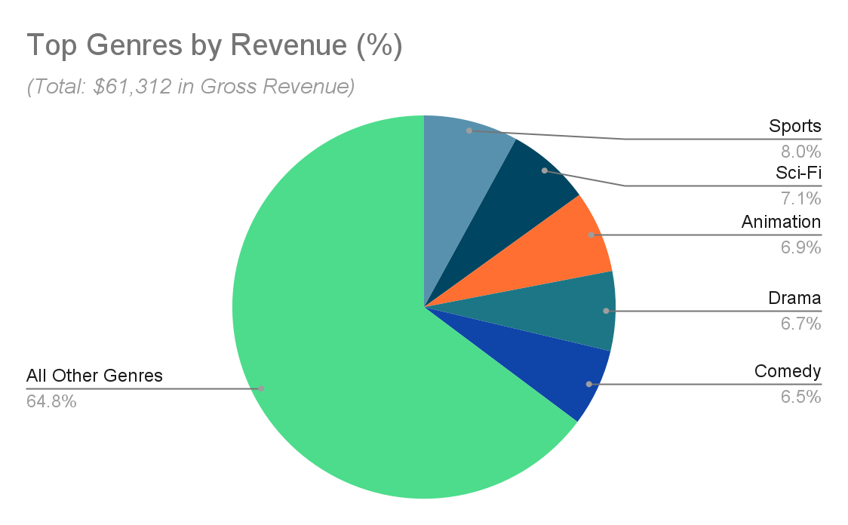
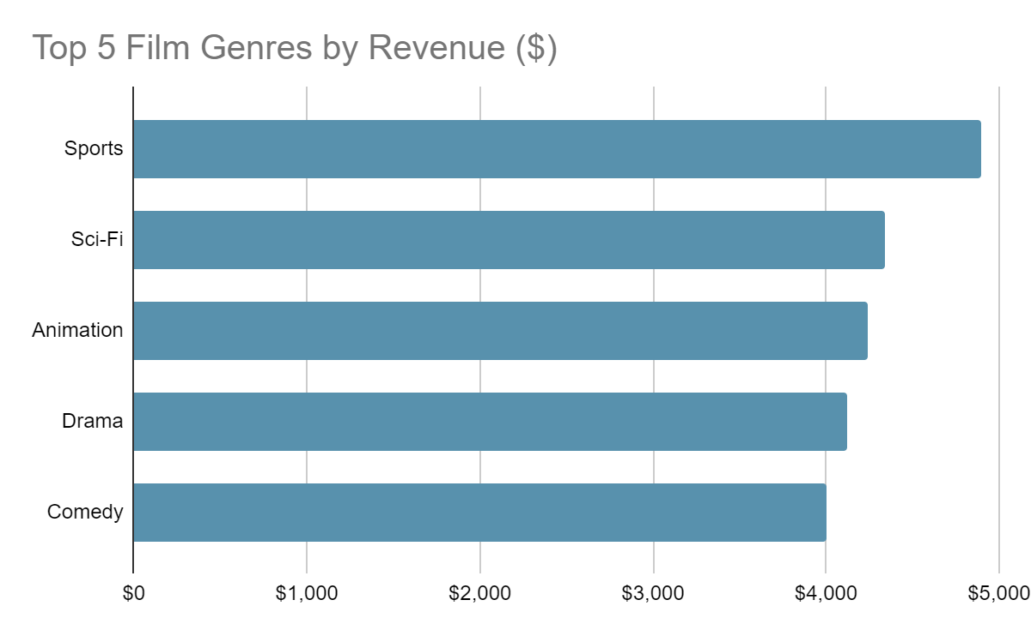
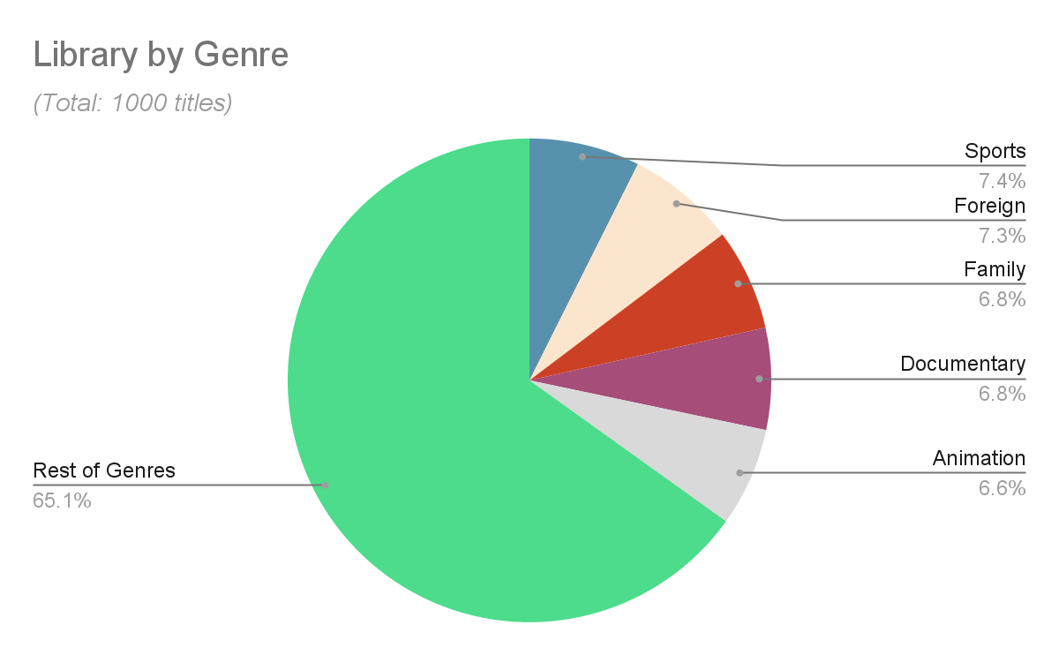
Movie Metrics
The largest genres in the film library are Sports, Foreign, Family, Documentary, and Animation films but only one of those genres, Sports, is a top-five revenue producer
Sports, Sci-Fi, Animation, Drama, and Comedy films were the top revenue-generating film genres
All 1000 film titles are in English

Slide 5
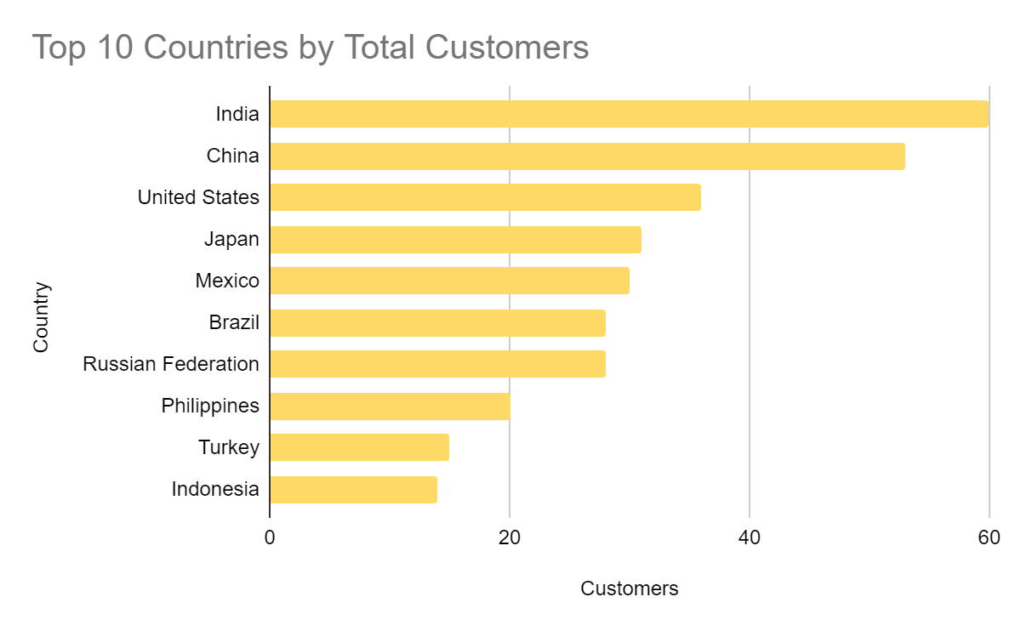
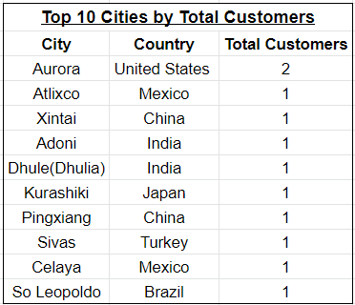
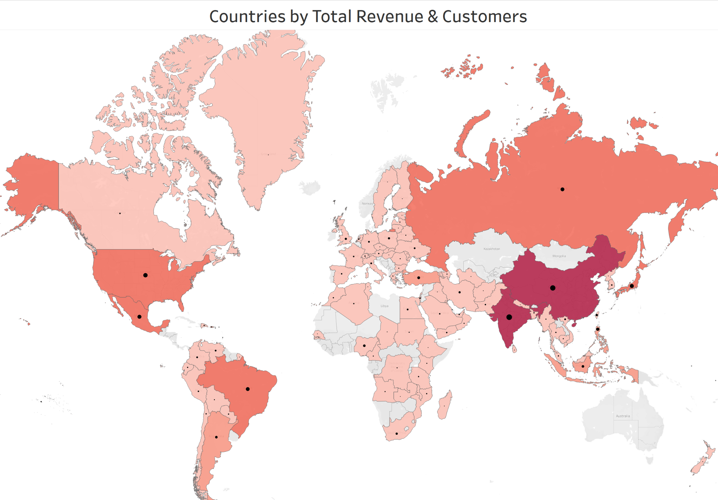
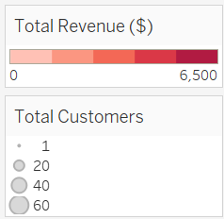
Our Market
India, China, USA, Japan, and Mexico account for 34.4% of total revenue
European sales were relatively weak and Australia is completely missing
The average customer rented 26.8 titles in a year
The customer base within our most important national markets, is evenly distributed as indicated by the top 10 cities by total customers
16,044
Rentals
599
Customers
26.8
Rentals per Customer
Above: Click on the image above to view the map in Tableau Public

Slide 6
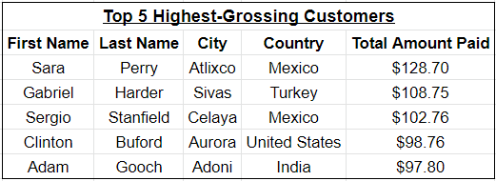
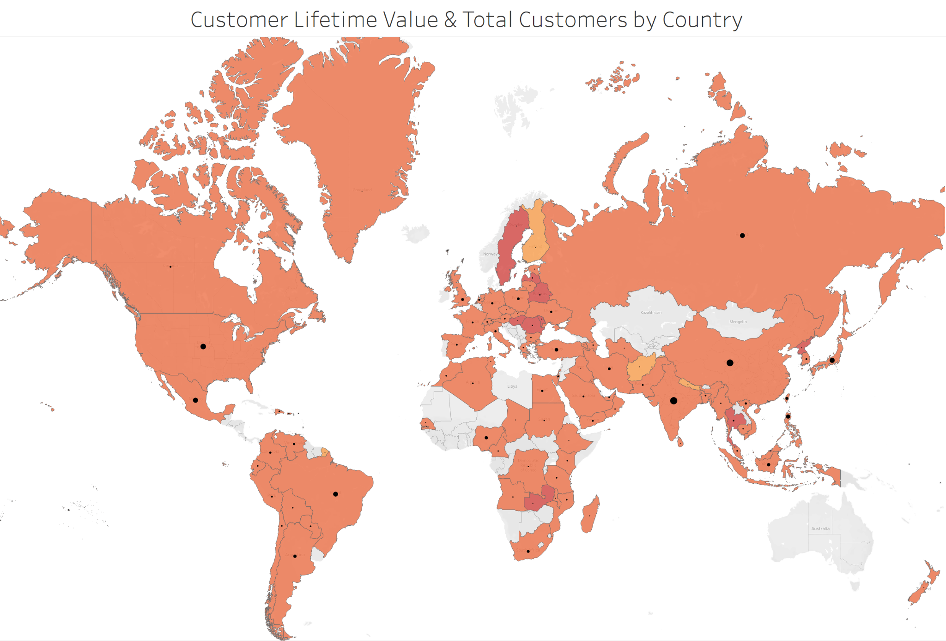
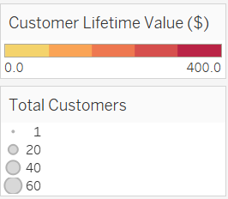
Customer Lifetime Value
Customer Lifetime Value is a measure of a customer’s revenue potential to a firm over the course of a business relationship, not just a single purchase
CLV = Average Value of a Purchase x No. Purchases per Year x Average Length of Customer Relationship
Customer Lifetime Value is relatively consistent across all markets.
There are pockets of smaller markets with higher-spending customers. These are probably early adopters ushering in our entrance into a particular country.
Above: Click on the image above to view the map in Tableau Public

Slide 7
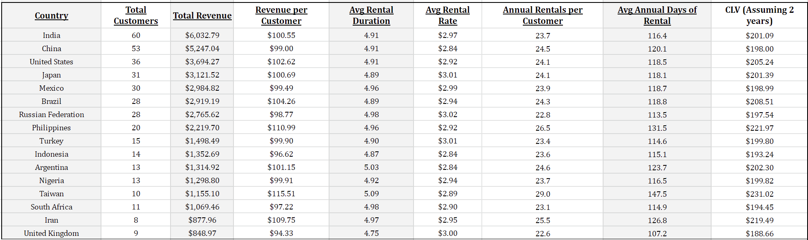
Where We Go Next
The chart below contains the top 16 countries by revenue and captures important metrics of customer behaviors in those markets.
Revenue is a function of the number and the pricepoint of the movies customers choose to rent. In some of our top-performing markets, customers rent lots of cheap of movies in a year, like Taiwan where customers rent an average of 29 movies per year at a rate of $2.89 while in other markets such as the UK, where customers rent 22.6 movies per year at a rate of $3.00
*Customer LIfetime Value (CLV) was calculated with the assumption of a two-year relationship which comes from a study of subscription length for streaming service subscribers. Netflix led the pack at 48 months, which is a standard Rockbuster will aspire to reach.

Slide 8
Recommendations
There is a relatively even mix of different film genres, except for the Thriller category with only a single title. We should experiment with a larger selection of Thriller movies, to gauge traction (or lack thereof) with audiences.
Make a larger selection of cheaper film titles available in high-volume, cost-conscious markets and make more high-cost titles available to consumers in low-volume, high-cost markets
Alter the mix of film genres to reflect the top revenue-generators. This means more Sci-Fi, Animation, Drama, and Comedy films
Make a concerted effort to enter the Australian market as entering this affluent, English-speaking country requires little change in our library
Acquire more foreign language titles to expand in our most customer-dense markets, specifically:
Spanish
Russian
Chinese Mandarin/Cantonese
Japanese
Tagalog
Portuguese

Slide 9
Questions?
Please Contact david@rockbuster.com
Visualizations Stored in Tableau Public

